Slide 1
Employee Data Analysis using Excel
STUDENT NAME: KAVYA SARA P
REGISTER NO: 312212812 (asunm14512022g62)
DEPARTMENT: B.COM (GENERAL)
COLLEGE: MAHALASHMI WOMEN’S COLLEGE OF ARTS AND SCIENCE.

Slide 2
PROJECT TITLE
Employee Performance Analysis using Excel

Slide 3


AGENDA
Problem Statement
Project Overview
End Users
Our Solution and Proposition
Dataset Description
Modelling Approach
Results and Discussion
Conclusion
3/21/2024 Annual Review

Slide 4

PROBLEM STATEMENT
Analyzing Employee Type Distribution
Objective:
To analyze the distribution of employee types (fixed term, permanent, temporary) across different departments and identify potential imbalances or disparities.
Scope:
Data Analysis: Examination of the provided dataset, which includes departmental names, employee type counts, and total results.
Departmental Comparison: Comparison of employee type distributions across various departments to identify any patterns or trends.
Efficiency Assessment: Evaluation of the balance between fixed-term, permanent, and temporary employees in each department, considering factors such as workload, project requirements, and organizational goals.
Recommendations: Formulation of recommendations for optimizing employee type distribution and improving departmental efficiency.

Slide 5
Expected Outcomes:
A comprehensive understanding of the employee type distribution within the organization.
Identification of potential imbalances or disparities in employee type allocation.
Recommendations for improving employee type distribution and departmental efficiency.
Project Deliverables:
Data analysis report, including key metrics and findings.
Comparative analysis of employee type distributions across departments.
Assessment of employee type balance and identification of areas for improvement.
Recommendations for optimizing employee type allocation and improving departmental efficiency.

Slide 6

PROJECT OVERVIEW
Purpose:
To analyze the distribution of employee types (fixed term, permanent, temporary) across departments and identify areas for improvement.
Goals:
Identify imbalances in employee type distribution.
Assess the balance of employee types within departments.
Develop recommendations for optimizing employee type allocation.
Scope:
Data analysis of departmental information, employee type counts, and total results.
Comparative analysis across departments.
Assessment of employee type balance.
Recommendations for optimization.
Methodology:
Data collection and analysis.
Departmental comparison.
Balance assessment.
Recommendation development.

Slide 7

WHO ARE THE END USERS?
Directly affected by resource allocation decisions.
May be impacted by changes resulting from the project
Employees working within the various departments of the organization.

Slide 8

OUR SOLUTION AND ITS VALUE PROPOSITION
Solution and Value Proposition:
Solution: Departmental Resource Allocation Optimization Framework.
Components: Data collection, analysis, comparison, assessment, and recommendations.
Value Proposition: Improved efficiency, departmental performance, productivity, reduced costs, employee satisfaction, and informed decision-making.

Slide 9
Dataset Description
Dataset: Contains information about departmental resource allocation.
Fields: Department, Count - Department, Count - Name.
Assumptions: "Count - Name" likely represents individuals assigned to projects.
Potential Analysis: Departmental size comparison, resource allocation analysis, efficiency assessment, bottleneck identification, comparison to departmental goals.
Considerations: Data quality, privacy, and visualization.

Slide 10

THE "WOW" IN OUR SOLUTION
Potential Situations in the Data
Uneven Resource Distribution: Departments with high or low "Count - Name" compared to "Count - Department."
Project-Oriented Departments: High "Count - Name" relative to "Count - Department."
Administrative or Support Functions: Low "Count - Name" relative to "Count - Department."
Inefficient Resource Utilization: High "Count - Name" with low productivity.
Overburdened Departments: Consistently high "Count - Name" over time.
3/21/2024 Annual Review
10

Slide 11
MODELLING
Data Cleaning and Preparation:
Handling Missing Values: Addressing any missing data points for "Count - Department" or "Count - Name."
Data Normalization: Ensuring consistency in data formats and units of measurement.
Outlier Detection and Correction: Identifying and addressing any extreme or unusual values that might skew the analysis.
Feature Engineering:
Creating Derived Metrics: Consider creating additional metrics such as "Resource Allocation Ratio" (Count - Name / Count - Department) to provide a more comprehensive understanding of resource utilization.
Categorical Encoding: If the "Department" field is categorical, converting it into a numerical format suitable for modeling.
Exploratory Data Analysis (EDA):
Visualization: Creating visualizations (e.g., histograms, scatter plots, box plots) to explore the distribution of variables, identify relationships, and detect patterns.
Correlation Analysis: Assessing the correlation between "Count - Department" and "Count - Name" to understand the relationship between departmental size and resource allocation.
11

Slide 12
Model Selection and Training:
Regression Analysis: Using regression models (e.g., linear regression, multiple regression) to predict the "Count - Name" based on the "Count - Department" and other relevant features.
Classification Models: If the goal is to classify departments into categories based on their resource allocation patterns, consider using classification models (e.g., decision trees, random forests, logistic regression).
Model Evaluation:
Performance Metrics: Assessing the model's performance using appropriate metrics (e.g., R-squared, mean squared error, accuracy, precision, recall, F1-score).
Cross-Validation: Evaluating the model's generalization ability using techniques like k-fold cross-validation.
Interpretation and Insights:
Understanding Model Coefficients: Interpreting the coefficients of the regression model to understand the impact of "Count - Department" and other features on "Count - Name."
Identifying Significant Predictors: Determining which features are most influential in predicting "Count - Name."

Slide 13
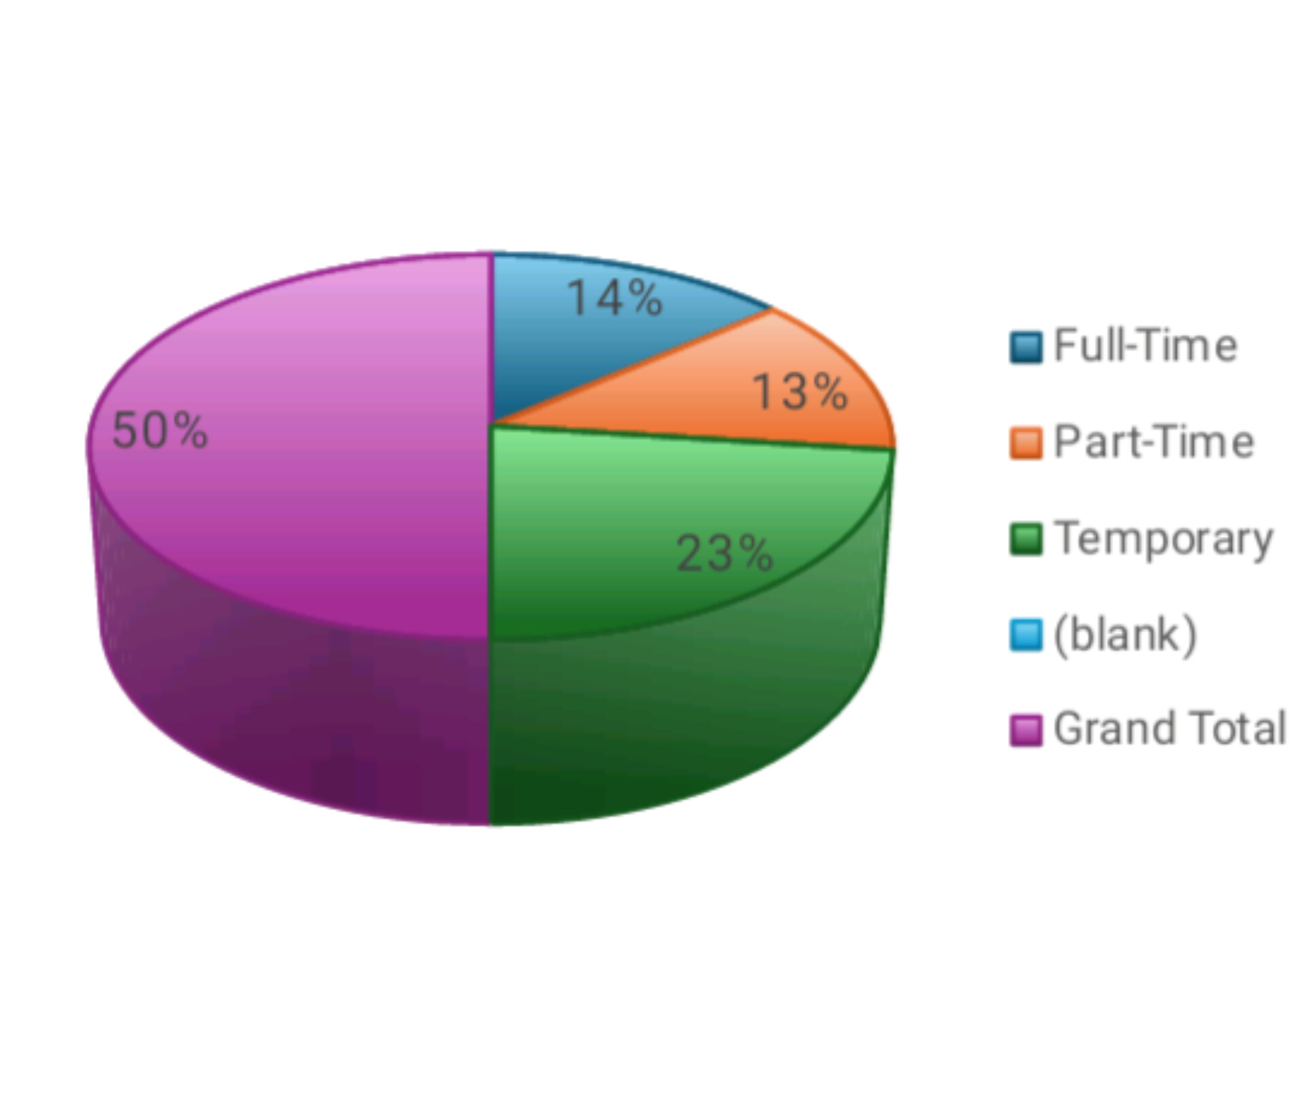
RESULTS
DEPARTMENT ANALYSIS
13

Slide 14
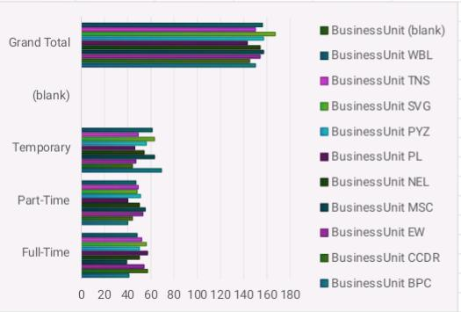
DEPARTMENT ANALYSIS

Slide 15
conclusion
Uneven resource distribution.
Project-oriented focus.
Administrative and support functions.
Inefficient resource utilization.
Overburdened departments.
Recommendations:
Re-evaluate resource allocation strategies.
Implement balanced resource distribution.
Promote strategic planning.
Enhance efficiency and productivity.
Address overburdened departments.

